Slide 1
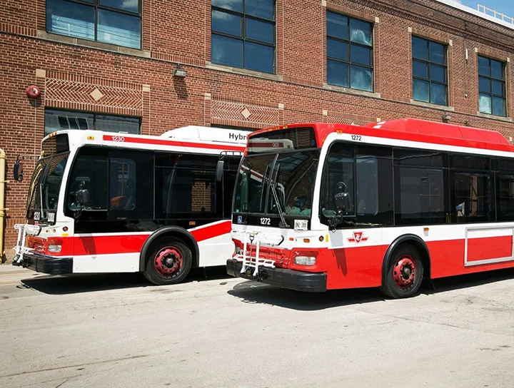
TORONTO BUS
DELAYS
GROUP 4
Pramudi Rajamanthri | - s14853
2. Vidura Chathuranga | - s15030
3. Chalani Wijamunige | - s15091

Slide 2


Introduction to the dataset
Toronto Transit Commission bus system
192 bus routes (including 28 night bus routes)
carry over 264 million riders
contains buses travelling 143 million kilometers in the year
This dataset contains data on delay cases reported during the first 6 months of 2022
in Toronto, Canada.

Slide 3

Variables of the Dataset
Date | Route | Time | Day | Location | Incident
Qualitative | Qualitative | Quantitative | Qualitative | Qualitative | Qualitative
Date of the delay incident | Route number | Time of the day | Day of the week | Location in Toronto | Incident which caused the delay
Min.Delay | Min.Gap | Direction | Vehicle
Quantitative | Quantitative | Qualitative | Qualitative
Amount of time which the bus got delayed | Time gap in minutes with the next bus scheduled | Direction of the route | Vehicle number of the bus

Slide 4


Problem Statement
What are the main factors affected the delay time of the buses in Toronto with in the first 6 months of 2022??

Slide 5



Pre-processing and Feature Engineering
Altered variables Direction
New variables created out of original variables Date Month Route Route_New Time Hour Day Is_Weekday Incident Incident_New
Removed variables Vehicle
Remove duplicated entries
Remove records having 0 as Min.Delay
Feature Engineering
Filter records with errors in days, time and route which were identified by referring to the "ttc bus system" website.
Impute missing values
Split the dataset into training and testing datasets

Slide 6


MAIN RESULTS OF THE DESCRIPTIVE ANALYSIS

Slide 7

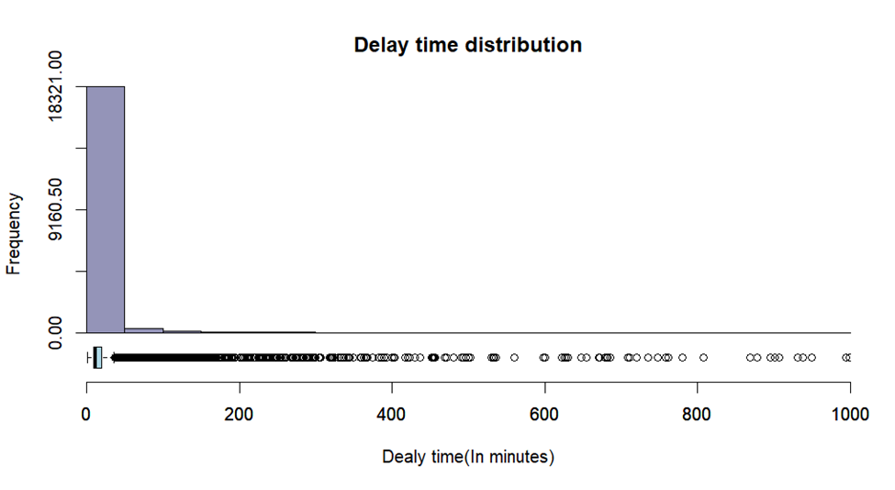
Skewness - 10.69332
Kurtosis - 148.4564
Boxplot Stats
Minimum – 1
1st Quartile – 9
Median – 12
3rd Quartile - 20
Maximum - 36
Mean - 20.9

Slide 8
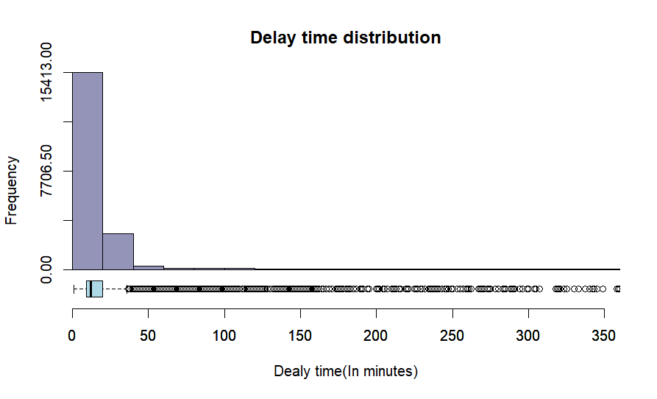

Skewness - 7.05678
Kurtosis - 62.70986
Boxplot Stats
Minimum – 1
1st Quartile – 9
Median – 12
3rd Quartile - 20
Maximum - 36
Mean – 18.3

Slide 9

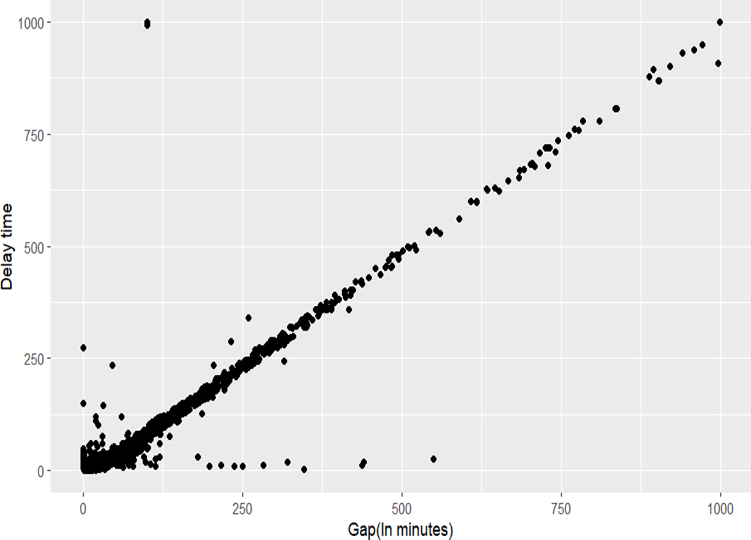
Delay Time Vs Time Gap
PERFECT POSITIVE LINEAR RELATIONSHIP
CORRELATION COEFFICIENT
0.96

Slide 10

HOW ARE THE CATEGORICAL VARIABLES RELATED WITH THE DELAY TIME????

Slide 11


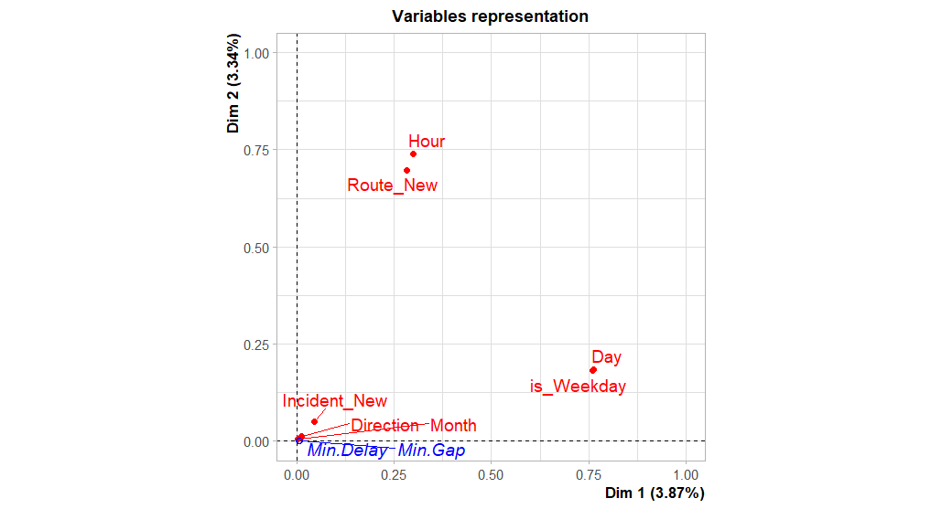
MULTIPLE CORRESPONDENCE ANALYSIS
RESULTS ARE UNSATISFACTORY !!!
THEN WHAT???

Slide 12

POSSIBILITIES :-
ONE WAY ANOVA TEST
(ASSUPTIONS SHOULD BE FULFILLED)
2. KRUSKAL WALLIS TEST
(WHEN ANOVA ASSUMPTIONS ARE VIOLATED)

Slide 13

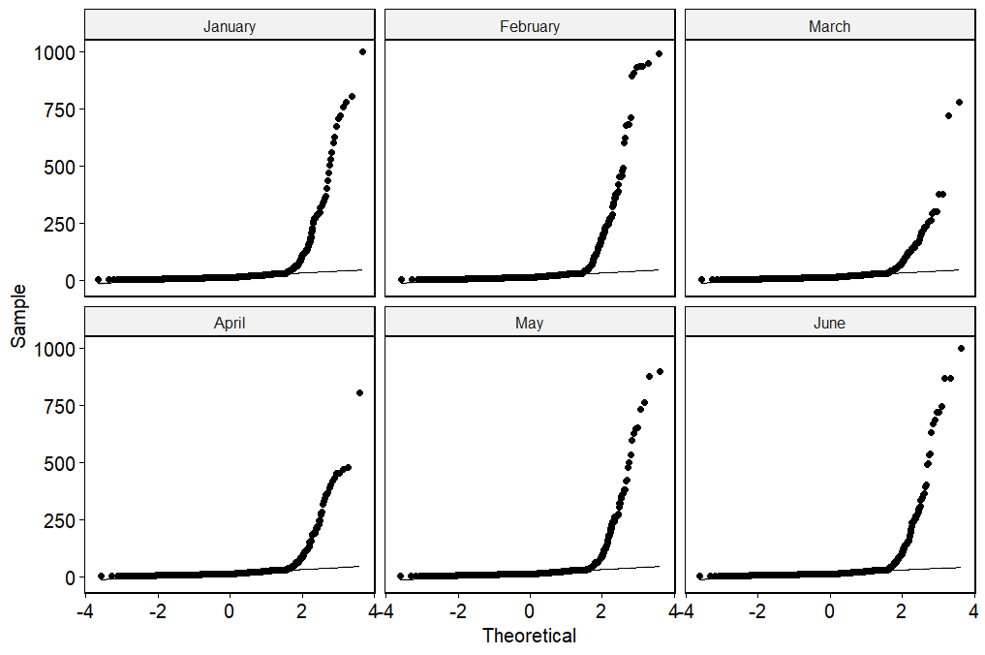
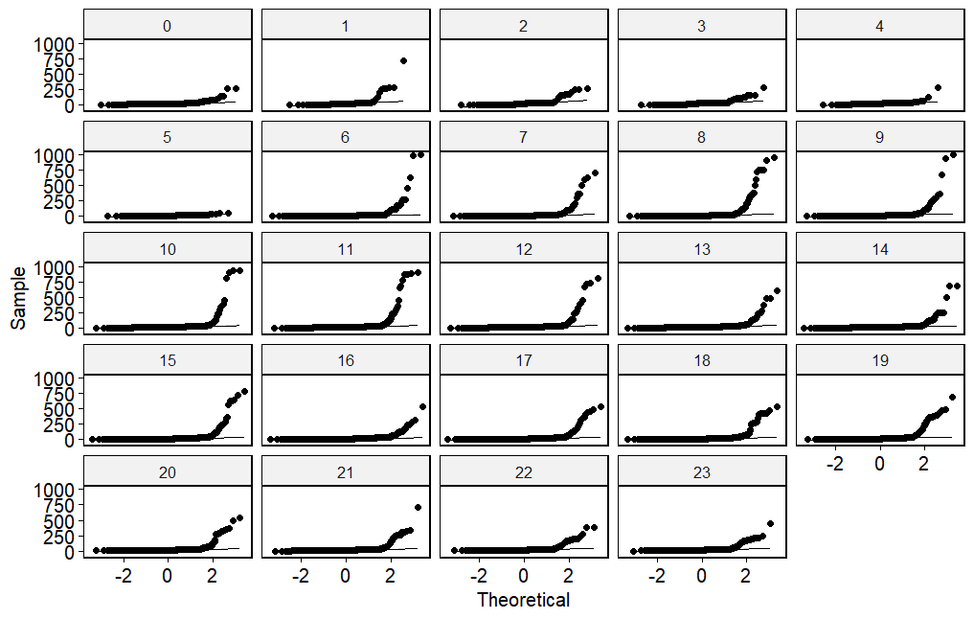
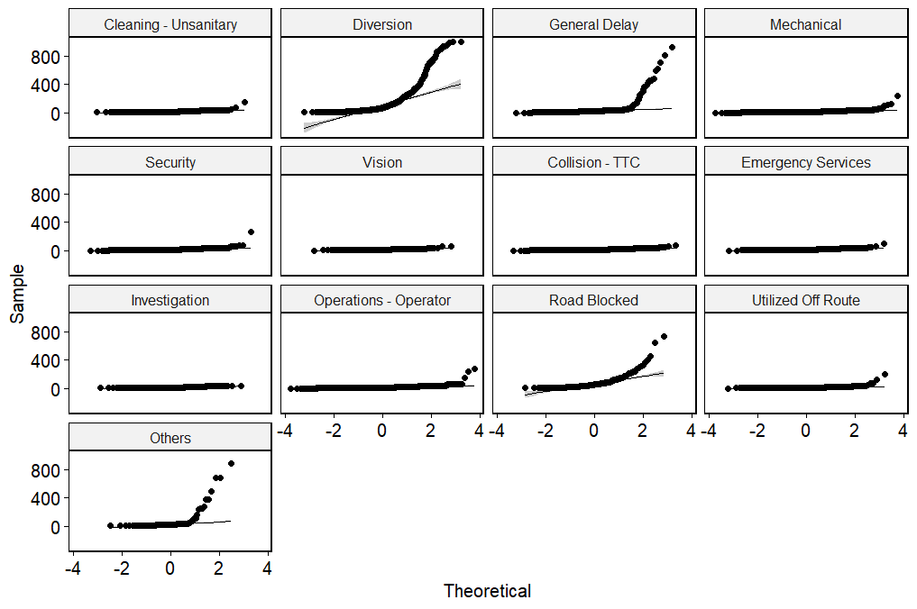
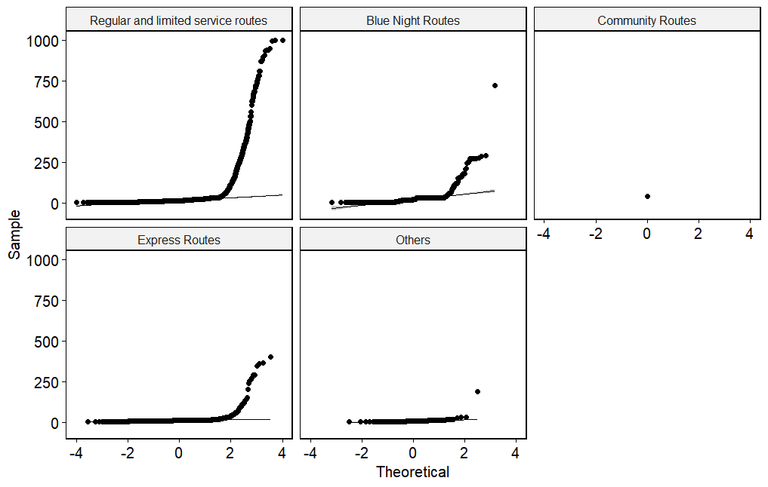
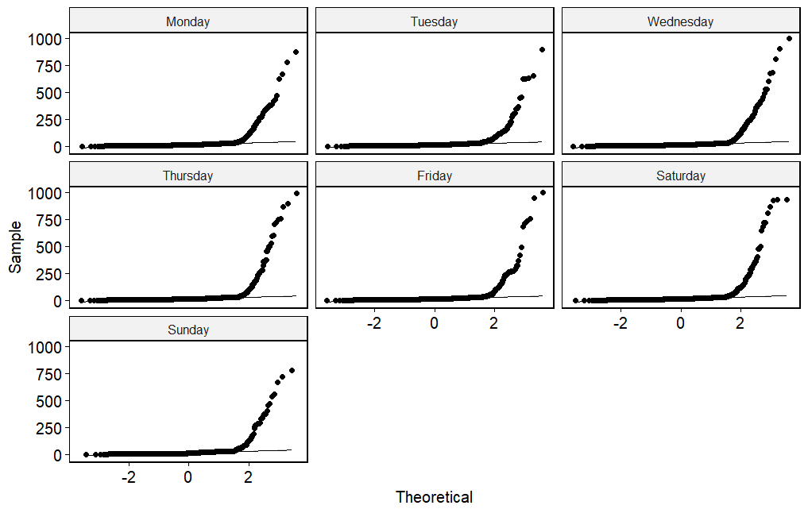
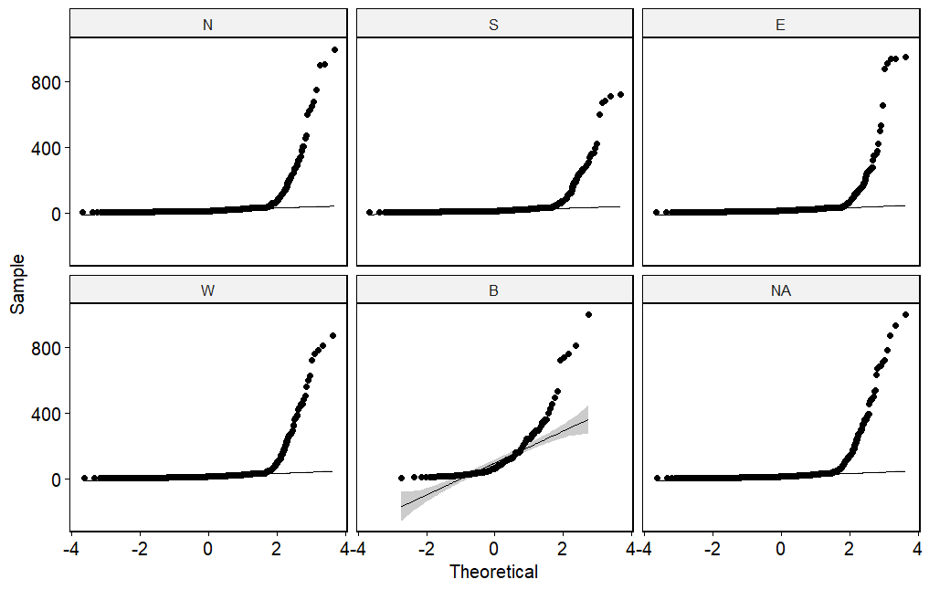
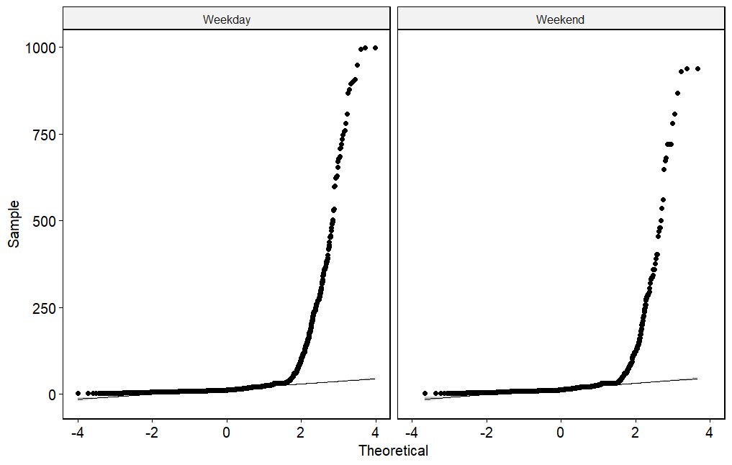
Checking the Normality assumption
6. Delay time By Incident_New
7. Delay time By Month
5. Delay time By Day
3. Delay time By Hour
2. Delay time By Direction
4. Delay time By is_Weekday
1. Delay time By Route type

Slide 14
HENCE, KRUSKAL WALLIS TEST….
Variable | P- value
Route_New | <2.2e-16
Direction | <2.2e-16
Hour | < 2.2e-16
Is_Weekday | 4.498e-06
Day | 3.314e-05
Incident_New | < 2.2e-16
Month | 0.2723
At 5% significance level, medians of the response variable, delay time by all the categories of the categorical variables except Month are significant which suggest there are effects be them on the delay time.

Slide 15
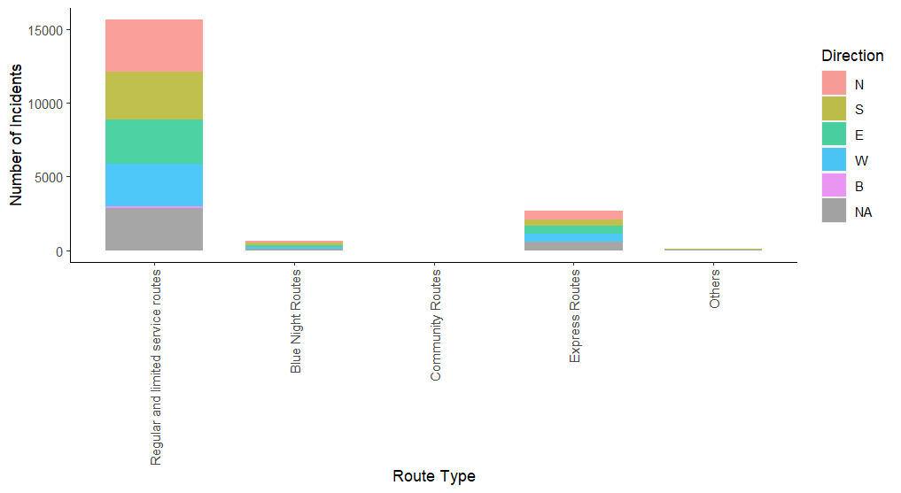

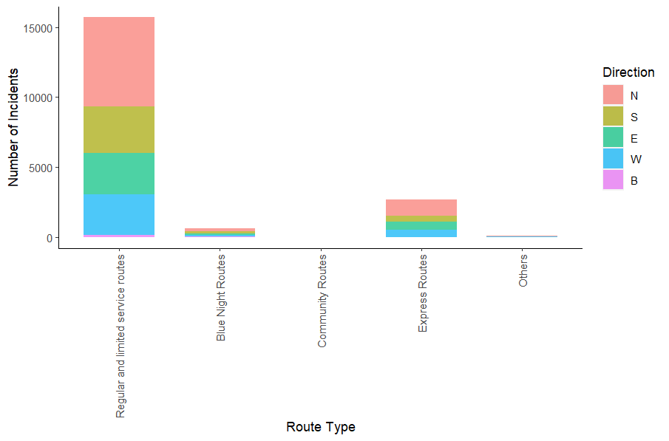

IMPACT OF THE ROUTE TYPE
REGULAR AND LIMITED SERVICES ROUTES RECORD THE HIGHEST NUMBER OF CASES.

Slide 16

WHAT ABOUT THE TIME BASED VARIABLES?

Slide 17
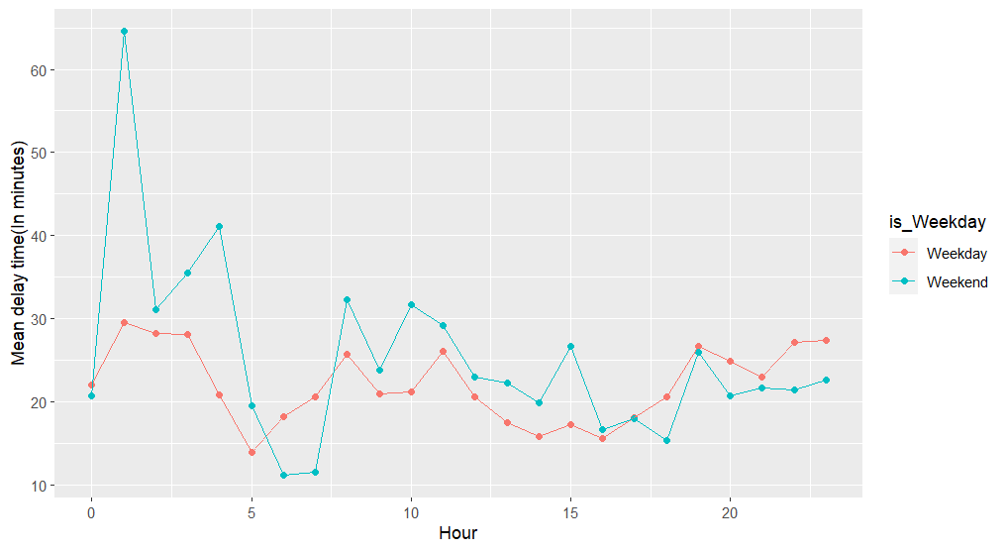
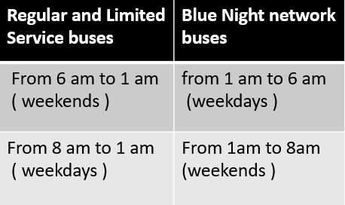

Contradicting mean values????

Slide 18
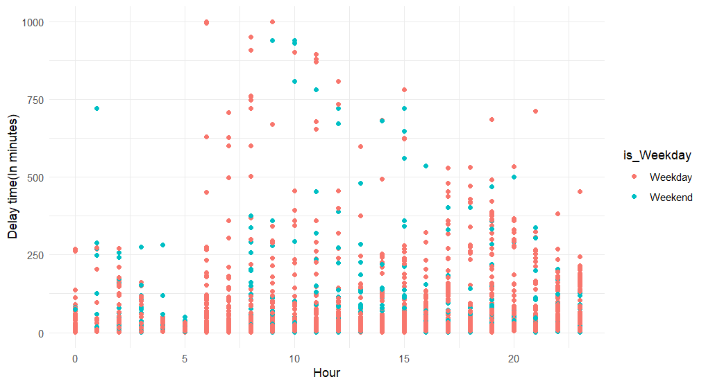

MAJORITY IS HERE

Slide 19
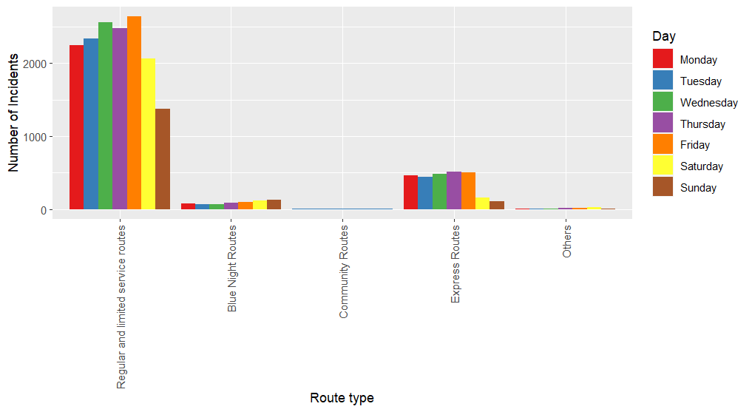
WHICH DAYS WERE THE WORST ???

Slide 20
IMPACT OF INCIDENTS ON DELAY TIME

Slide 21
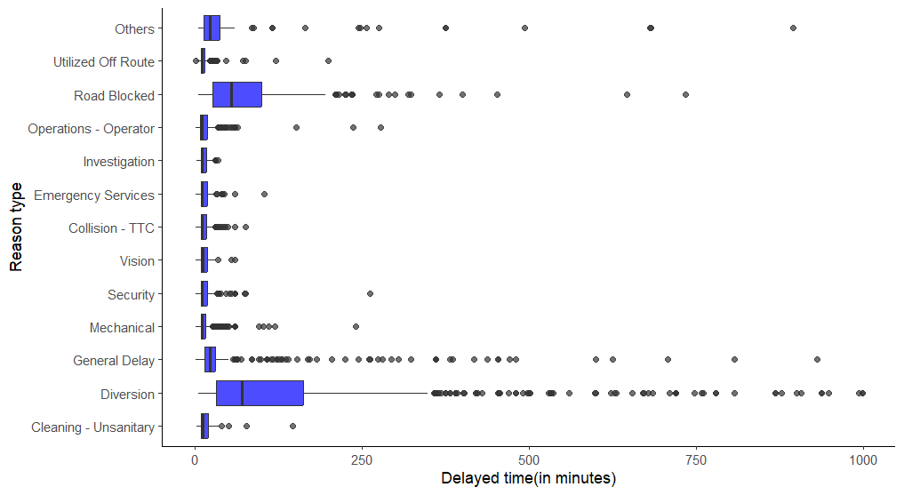


Slide 22
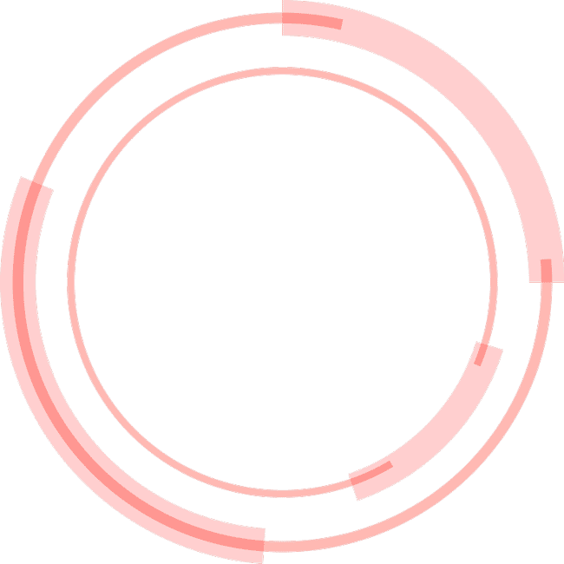
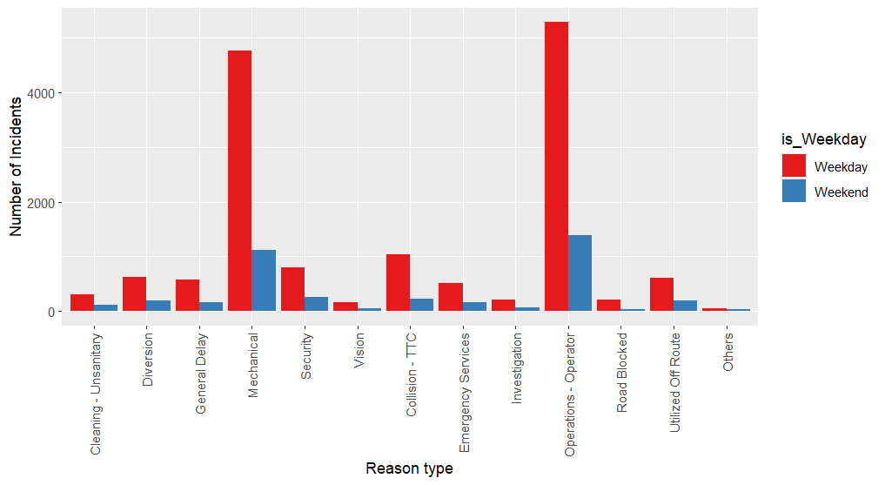
IMPACT OF THE INCIDENTS ON DELAY TIME
Majority :-
Operations - Operator
Mechanical Problems

Slide 23
THE BIG PICTURE

Slide 24
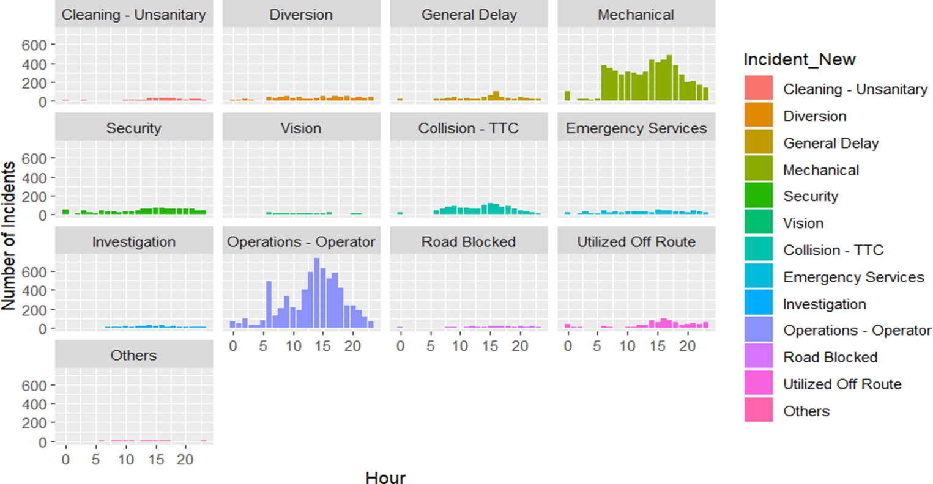

Slide 25

SUGGESTIONS FOR A QUALITY ADVANCED ANALYSIS

Slide 26
We identified that the response variable, delay time has a skewed distribution with 994 outliers. Therefore, transformations can be used in order to reduce the effect of outliers and the variance in data.
1. Logarithmic transformations
2.Square root function
3.Box Cox transformation etc.
In the beginning of the descriptive analysis we identified t the delay time has a skewed

Slide 27

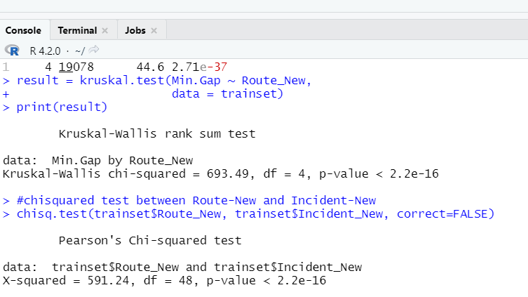
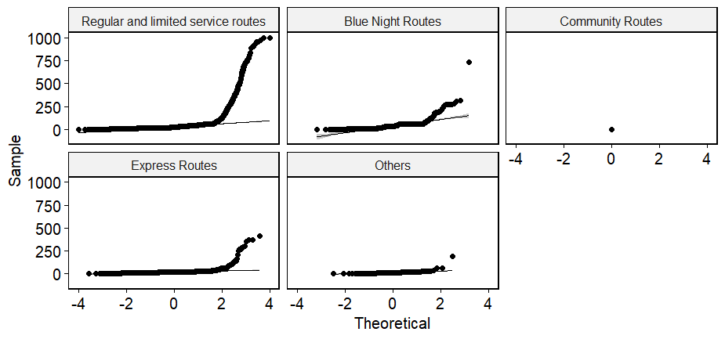


Examining relationships between predictors
i)Time gap Vs Route type
To perform One Way ANOVA checking the assumptions :-
KRUSKAL WALLIS TEST
At 5% significance level, medians of the time gap variable, by all the categories of the Route_New variable are significantly different which suggest there are effects by them on the time gap.
Normality assumption is violated

Slide 28


We can conclude that relationships exist between the predictors causing the delay time .
Hence ,
Ridge Regression
Lasso Regression
Elastic Net regression
Random Forest Regression
XG Boost
ii) Route_New Vs Incident_New
At 5% significance level, there is a significant association between the variables Route_New and Incident_New.
Advanced Analysis Approaches

Slide 29
REFERENCES
TTC data and journals
https://www.ttc.ca/
https://transittoronto.ca/bus/8108.shtml
https://en.wikipedia.org/wiki/List_of_Toronto_Transit_Commission_bus_routes
https://www.blogto.com/city/2014/04/when_exactly_is_rush_hour_in_toronto/
Descriptive Analysis
Multiple Correspondence Analysis
https://www.google.com/amp/s/www.r-bloggers.com/2017/05/how-to-interpret-correspondence-analysis-plots-it-probably-isnt-the-way-you-think/amp/
https://rpubs.com/gaston/MCA
Kruskal Wallis test
https://onlinelibrary.wiley.com/doi/10.1002/9780470479216.corpsy0491
Advanced Analysis suggestions
https://osf.io/wc45u/download
https://towardsdatascience.com/random-forest-regression-5f605132d19d
https://machinelearningmastery.com/gentle-introduction-xgboost-applied-machine-learning/

Slide 30
